Slide 1

Scheduling Algorithms in Operating Systems
This presentation explores key scheduling algorithms used by operating systems to manage CPU resources for various types of processes. We'll delve into their mechanisms, benefits, and drawbacks.

Slide 2
Introduction to Scheduling Algorithms
What are they?
Why are they important?
Scheduling algorithms are rules that operating systems use to decide which process should be executed next on the CPU. They determine the order and duration of process execution.
Scheduling is critical for efficient system performance. It ensures fair allocation of CPU time, optimizes resource utilization, and minimizes wait time for processes.

Slide 3

FCFS: First-Come, First-Served
1
Definition
2
Advantages
FCFS is a non-preemptive algorithm where processes are executed in the order they arrive in the ready queue.
Simple and easy to implement, suitable for batch processing systems.
3
Disadvantages
Can lead to the "convoy effect" where a long process blocks shorter ones, resulting in poor performance for short processes.

Slide 4
Round Robin (RR)
Definition
Advantages
Disadvantages
RR is a preemptive algorithm where each process is allocated a fixed time slice (quantum) and executed in a cyclic manner.
Fair to all processes, suitable for interactive systems with user-intensive applications.
High context-switching overhead if the quantum is too small, inefficient for CPU-bound processes if the quantum is too large.

Slide 5

Priority Scheduling
Definition
Advantages
Disadvantages
Processes are assigned priority levels, and those with higher priorities are executed first.
Suitable for real-time systems where critical processes need to be executed promptly, ensures timely response to time-sensitive events.
Can lead to starvation of low-priority processes, requires a robust priority assignment mechanism to prevent unfairness.

Slide 6
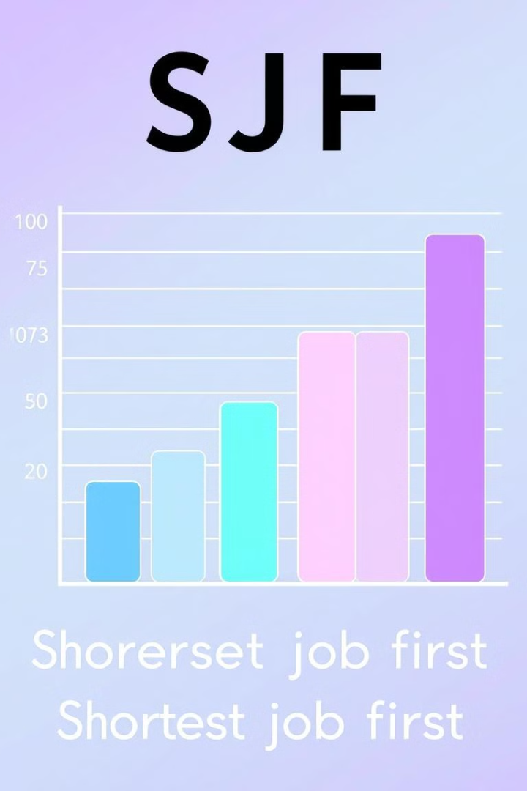



Shortest Job First (SJF)
Definition
Advantages
Processes with the shortest execution time are scheduled first, minimizing overall wait time.
Optimal for batch systems where the goal is to minimize average wait time.
Disadvantages
Requires knowledge of process burst times, which can be unpredictable in real-world scenarios, can lead to starvation of long processes.

Slide 7
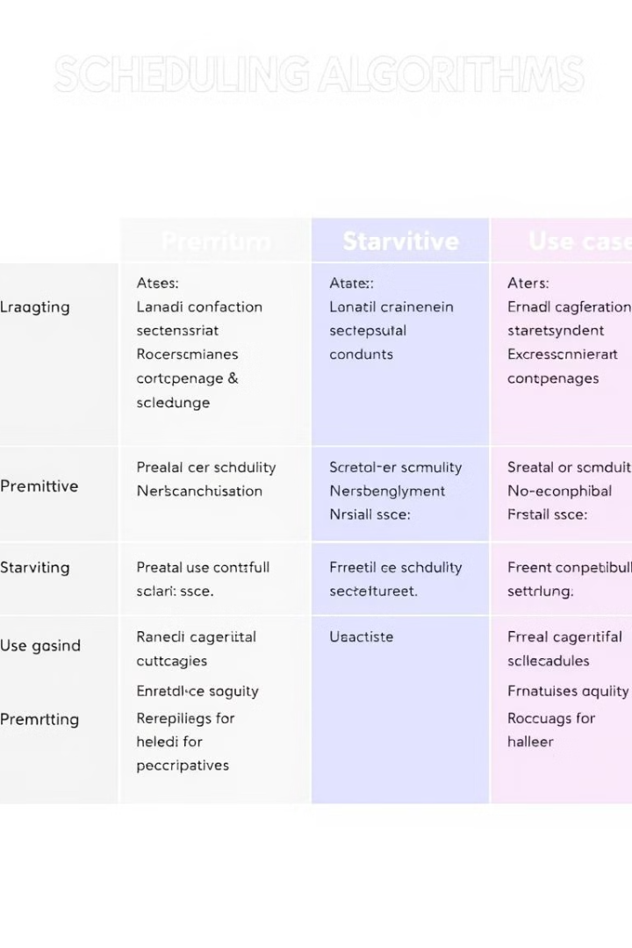
Comparison of Scheduling Algorithms
Algorithm
Preemptive
Starvation
Use Case
FCFS
No
Yes
Batch systems
RR
Yes
No
Interactive systems
Priority
Yes/No
Yes
Real-time systems
SJF
Yes/No
Yes
Batch systems

Slide 8

Thank You

